Slide 1
Post-Quantum Cryptographic Hardware Primitives on FPGAs - based on Ring-Learning with Errors (R-LWE) and Code-based
Rashmi Agrawal and Lake Bu
ASCS Lab

Slide 2
Presentation Flow
Motivation
Why quantum-proof?
NIST
Steps towards standardization
Design Workflow
R-LWE
State of the art
Implementation
Results
Code-based
State of the art
Proposed algorithm
Notes:
I will walk you through the needs of having quantum-proof, updates on the standardization process, our design workflow, then we will dive into the details of Ring-LWE algorithm and its implementation. Lake will cover Code-based cryptosystem after that.

Slide 3
Presentation Flow
Motivation
Why quantum-proof?
NIST
Steps towards standardization
Design Workflow
R-LWE
State of the art
Implementation
Results
Code-based
State of the art
Proposed algorithm
Notes:
Let’s start with answering the question i.e. why do we need quantum proof cryptosystems

Slide 4
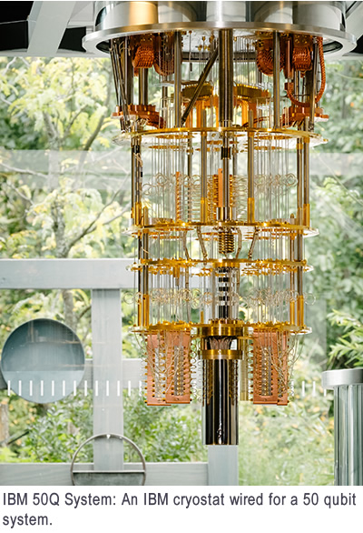
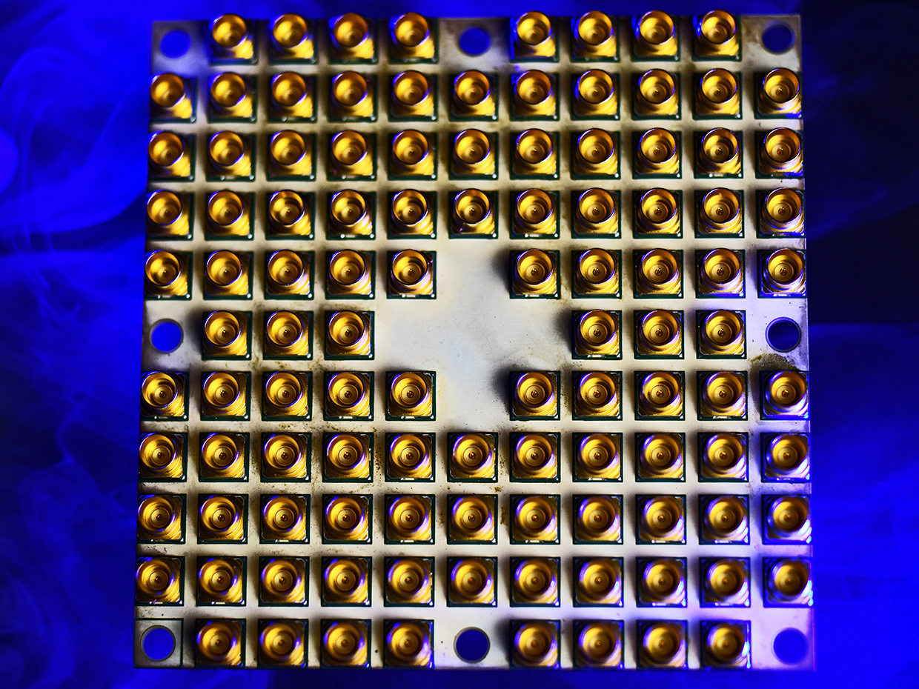
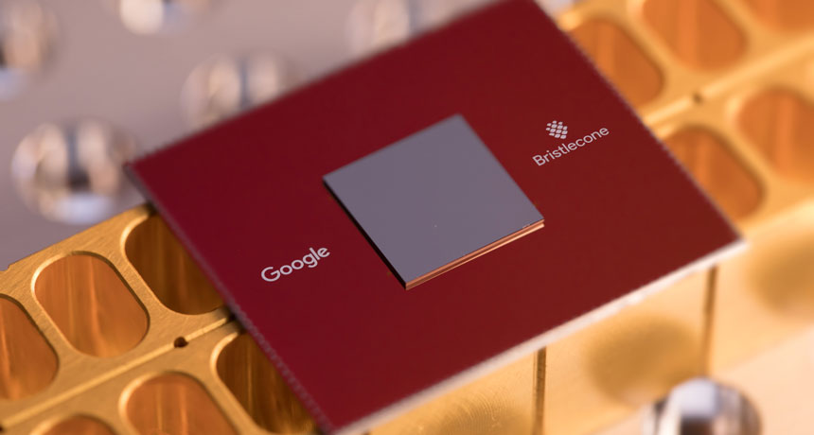
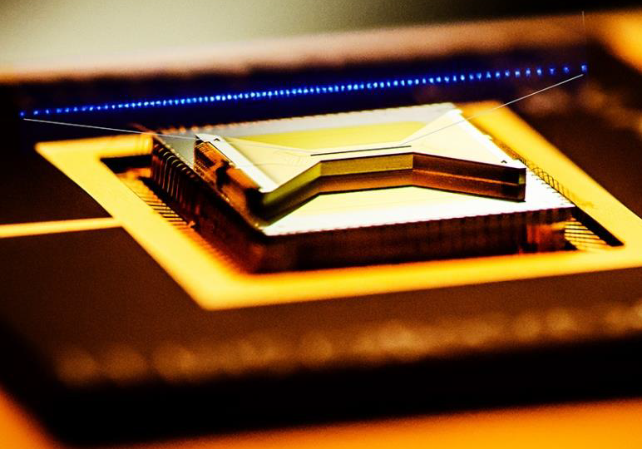
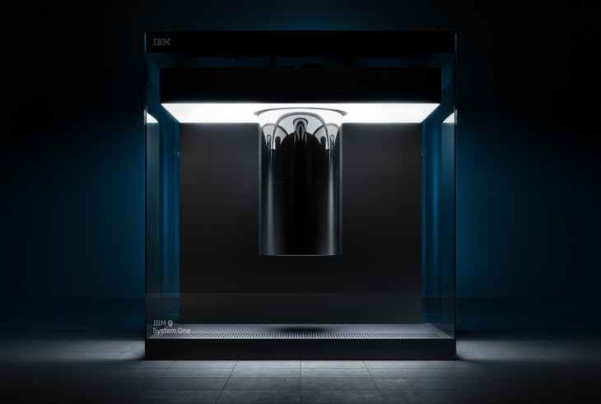
Ongoing Development
Intel 49 Qubits
Google 72 Qubits
IBM 50 Qubits, 20 Qubits
IonQ 160 Qubits
Notes:
This slide shows the ongoing development in the field of Quantum Computers.
Qubits mentioned here are Physical qubits & actual useful qubits or the logical qubits may be just ½ or 2/3 of the physical qubits. Typically many physical qubits get used up to provide stability, error-correction and fault tolerance needed to perform useful computations

Slide 5
When Quantum Computers Come …
Who is NOT considered as post-quantum secure?
Algorithm | Secure in Post-quantum Era?
RSA-1024, -2048, -4096 | No
Elliptic Curve Crypto (ECC)-256, -521 | No
Diffie-Hellman | No
ECC Diffie-Hellman | No
AES-128, -192 | No
[1]
[1] https://www.nist.gov/
Notes:
What does this development mean to us? NIST published an interesting survey which shows that when quantum computers get commercialized most of the classical cryptographic algorithms for symmetric key exchange will not be secure and none of the Public key algorithms will be secure. With quantum supremacy even the 4096 bit RSA algorithm will not be secure.

Slide 6
Question
Can we increase the key size of some popular encryption schemes, so that they can be post-quantum secure?
Maybe yes, maybe no.
Table II. Equivalent Security Levels of AES and RSA under Attacks from Classic and Quantum Computers *
Attack Platform | Symmetric Encryption |  |  | Asymmetric (Public-key) Encryption
 | Algorithm | Key Size | Security Level | Algorithm | Key Size | Security Level
Classic Computers | AES-128 | 128 | 128 | RSA-2048 | 2,048 | 112
 | AES-256 | 256 | 256 | RSA-15360 | 15,360 | 256
Quantum Computers | AES-128 | 128 | 64 | RSA-2048 | 2,048 | 25
 | AES-256 | 256 | 128 | RSA-15360 | 15,360 | 31
*
Grover’s algorithm
Shor’s algorithm
* TechBeacon, Waiting for quantum computing: Why encryption has nothing to worry about, 2018
Notes:
An interesting question to ask ourselves is
NIST prescribed 112 bits as the minimum security level required. Grover’s algorithm operates using Brute force search approach which reduces the key search space to its square root (2^128 reduced to 2^64). Shor’s algorithm is quantum Fourier transform which reduces the key space to 2^25 & 2^31. What remains to use is large AES and large Hash which gives us at least 128 bit security which is barely enough.

Slide 7
How Pressing is the Issue?
Current Situation of Quantum Computers
2011: 14 calcium ion qubits
2017: IBM 50-qubit quantum computer
2018: Google 72-qubit quantum computer
2018: 16 superconducting qubits
2018: 18 fully entangled photon qubits
2019: IBM Q-system 20-qubit commercialized
Major Things that Need to Be Done
Increasing the size (# of qubits)
Error correction (need even more # of qubits)
Computation verification (of its correctness)
Quantum Supremacy: 49 qubits, and a two-qubit error below 0.5% *
* Google Quantum AI Lab: A Preview of Bristlecone, Google’s New Quantum Processor, 2018
Notes:
We know that IBM has already launched first commercial quantum computer with 20 qubits. What we are going to experience soon is the quantum supremacy i.e. quantum computers with large number of qubits with qubit error below 0.5%

Slide 8
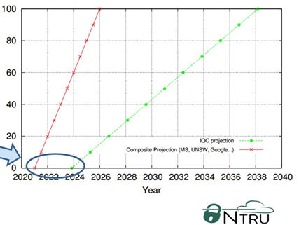
How Far Is It From Us?
The Projected Timeline of General Quantum Computers
Early 2015 Projection
Late 2015 Projection
Arrival Window
(1 ~ 5 yr)
[1]
[1] Lee Wilson, The Rise of Quantum Computers – The Current State of Cryptographic Affairs, 2016
Notes:
And how far are we from seeing the quantum supremacy? NTRU published a good insight on this. Early 2015 they projected a timeline that commercial qc will be first available in 2024 and readily available by 2038. But developments in the field made them do second projection in late 2015 saying that commercial qc will be available in 2021 and readily available by 2026. which reduced the window by 5 years. Moreover we know that IBM launched first qc in 2019 which further narrows down the gap.

Slide 9
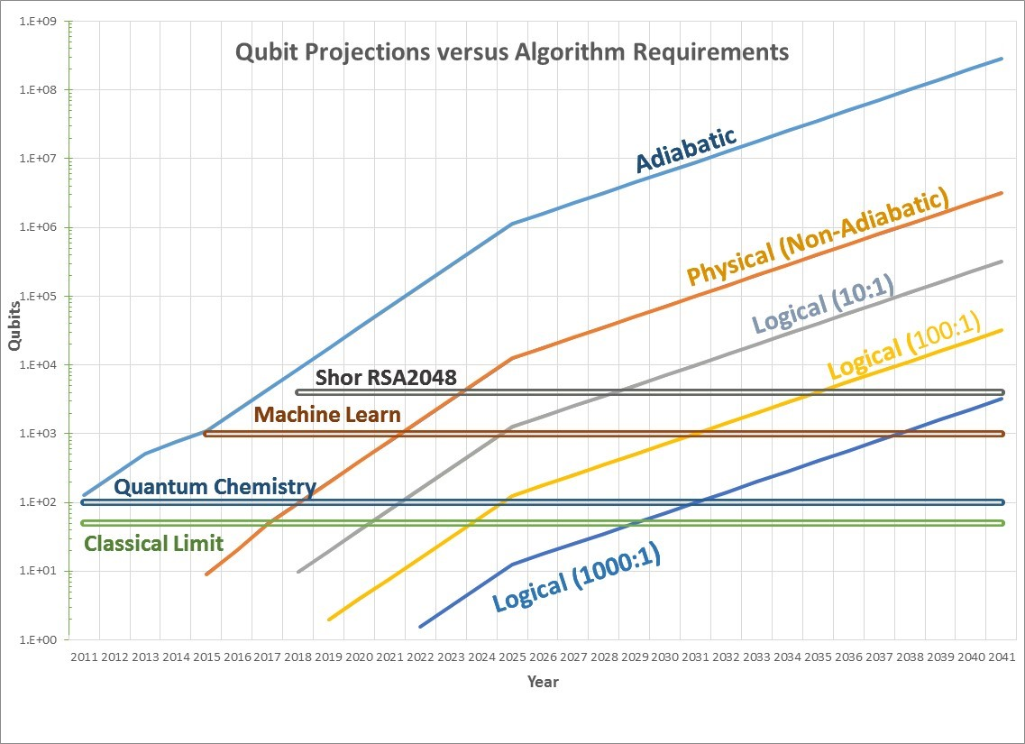
Applying Moore’s Law to Quantum Computers
(1 ~ 5 yr)
[1]
2023
2028
[1] https://quantumcomputingreport.com/our-take/applying-moores-law-to-quantum-qubits/
Notes:
Researchers also started applying Moore’s law to QC and by the past experience from 2011 they found that Moore’s law fits pretty well to QC and they can do reasonable predictions for future. By this prediction RSA will be broken between the year 2023 and 2028 which matches the prediction on the previous slide which is 2026.

Slide 10

Quantum Computer-based Cryptography vs General Computer-based Quantum-proof Cryptography
Notes:
Having to develop quantum computer-based cryptography is rich man’s solution like Iron man & batman. Developing conventional computer based quantum proof solutions is a common man’s approach like spiderman.

Slide 11


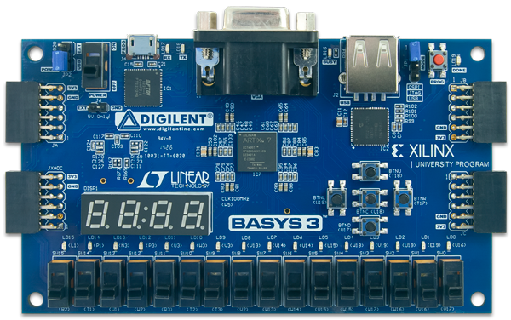
Quantum Computer-based Cryptography vs General Computer-based Quantum-proof Cryptography
Notes:
As soon as one powerful QC can be built by IBM or Google or Intel, conventional cryptosystems will not be secure. But still it will take at least a decade for everyone to move to quantum computer-based defenses. So, we would envision that, for 5-10 years, silicon based Quantum-Proof solutions such as FPGA will still be mainstream for researchers, banks and various govt. agencies. Another advantage is that what ever Quantum-proof solutions are getting implemented now on FPGA, can still be implemented on Quantum Computers. So, we are building a solution for now and for tomorrow.

Slide 12
Presentation Flow
Motivation
Why quantum-proof?
NIST
Steps towards standardization
Design Workflow
R-LWE
State of the art
Implementation
Results
Code-based
State of the art
Proposed algorithm
Notes:
Let’s now see how is NIST doing in standardizing Post-Quantum Crypto

Slide 13
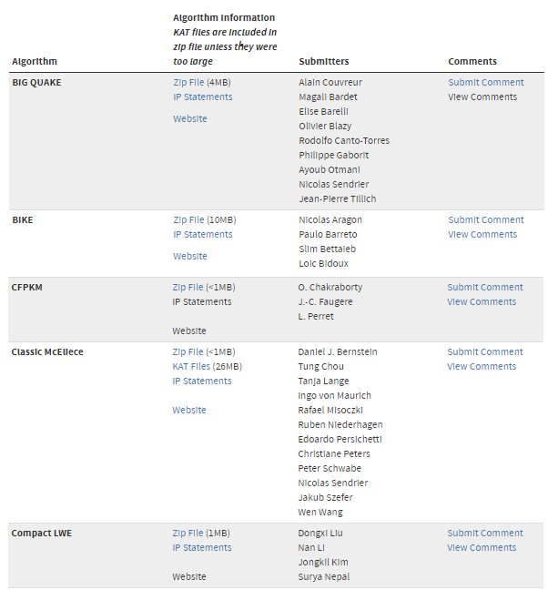
Post-Quantum Cryptography (PQC) Standardization (Round -1)
NIST
Jan 2017 – Dec 2018
Evaluating 69 (5 withdrawn) submissions of PQC, to bring up a standard (just like AES or RSA):
21 lattice-based
18 code-based
Some hash-based
Some others
[1]
Submission deadline Nov 30, 2017. List updated Dec 20, 2018.
[1] https://csrc.nist.gov/projects/post-quantum-cryptography/round-1-submissions
Notes:
First round of submissions ran from Jan 2017 to Dec 2018 and some 69 submissions were done. Out of these submissions, 21 were lattice-based, 18 were code-based, some hash-based for digital signatures and few others.

Slide 14
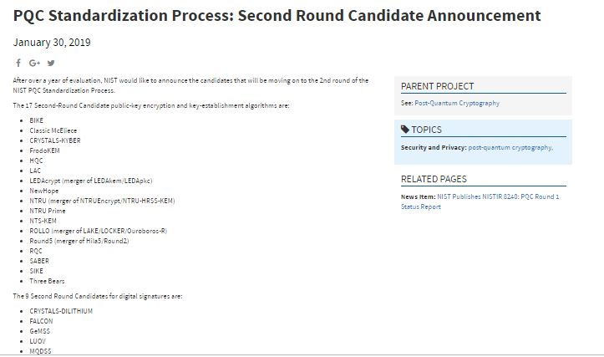
Post-Quantum Cryptography (PQC) Standardization (Round -2)
NIST
Jan 30, 2019 published candidates of Round-2:
27 submissions
Who survived?
12 lattice-based
8 code-based
some multivariate-based and hash based for digital signatures
Notes:
In Jan 2019 NIST published first round results. Out of some 69 submissions only 27 submissions were declared as the second round candidates. Who survived the battle? Lattice based, code based and few other multivariate based and some hash-based for digital signatures.

Slide 15
Post-Quantum Cryptography (PQC) Standardization (Round -2)
Sr. No. | Public-Key Encryption
 | Lattice-based/Ring-LWE |  | Code-based |  | Other
1 | NTRU Prime | (R-lattice) | Classic McEliece | (Binary Goppa)
2 | NTRU European Encryption Standard | (R-lattice) | HQC | (BCH & cyclic)
3 | LAC | (R-LWE) | RQC | (cyclic)
4 | SABER | (Mod-LWR) | LEDA | (LDPC)
5 | Round5 | (R-LWR) | ROLLO (LAKE & LOCKER) | (LRPC)
Notes:
Let’s take a closer look at the 2nd round. We have 5 candidates in Lattice-based and 5 candidates in code-based. So the competition is actually close here. But one important note here is while the RLWE algorithms or even for code-based algorithms may have different name, they still follow a similar scheme for encryption and decryption. We are working on designing standard algorithms for both. So whoever wins, we can tweak the design accordingly and switch to new algorithm easily.

Slide 16
Post-Quantum Cryptography (PQC) Standardization (Round -2)
Sr. No. | Key Establishment/Encapsulation
 | Lattice-based/Ring-LWE |  | Code-based |  | Other
1 | NewHope | (R-LWE) | BIKE | (MDPC) | SIKE (Isogeny)
2 | NTRU European Encryption Standard | (R-lattice) | NTS-KEM | (Binary Goppa)
3 | FrodoKEM | (R-LWE) | LEDA | (LDPC)
4 | CRYSTALS-KYBER | (R-LWE) | ROLLO (LAKE & LOCKER) | (LRPC)
5 | SABER | (Mod-LWR)
6 | Three Bears | (Mod-LWE)
Notes:
For symmetric key exchange, we have 6 candidates which are lattice-based, only 4 as code-based and one other candidate.

Slide 17
Post-Quantum Cryptography (PQC) Standardization (Round -2)
Sr. No | Digital Signature
 | Lattice-based/Ring-LWE |  | Multivariate-based | Hash-based
1 | FALCON | (NTRU R-lattice) | GeMSS | Picnic
2 | qTESLA | (R-LWE) | MQDSS | SPHINCS+
3 | CRYSTALS-DILITHIUM | (R-LWE) | LUOV
4 |  |  | Rainbow
Notes:
For digital signatures, we have 3 lattice-based candidates. Code-based cannot be used for digital signatures. 4 candidates that are multivariate-based. And 2 are hash-based. Another thing to note here is that Multivariate-based scheme may look different but same submodules can be reused as it also involves performing polynomial operations.

Slide 18
Presentation Flow
Motivation
Why quantum-proof?
NIST
Steps towards standardization
Design Workflow
R-LWE
State of the art
Implementation
Results
Code-based
State of the art
Proposed algorithm
Notes:
Now let’s look at the design workflow

Slide 19
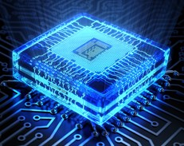
Design Workflow
Understanding the Algorithm and Math
Understanding the algorithmic optimizations for Hardware Implementation
Implementing a small-size example
Design & implement top-level architecture
Design FSM of three sub-modules i.e. Key Generation, Encryption & Decryption
Implement basic operators i.e. add, sub, mul, division
Integration and Testing
Notes:
Step-1 is to understand the underlying algorithm and maths. Once we got familiar with the algorithm and the maths, we tried looking for ways to optimize the algorithm for efficient hardware implementation. After that we went on to implement a small-size example in software to get intuitive knowledge on how the algorithm will work and also to check if our understanding of the algorithm was correct. After that we designed the top-level architecture of our scheme and then we went on designing the flow diagram and FSM of three sub-modules i.e. KeyGen, Enc and Dec. Then we implemented basic operators like add, sub, mul and division. Last step was to integrate the modules and test the functionality of the entire system. Few iterations gave us the final PKC.

Slide 20
Presentation Flow
Motivation
Why quantum-proof?
NIST
Steps towards standardization
Design Workflow
R-LWE
State of the art
Implementation
Results
Code-based
State of the art
Proposed algorithm
Notes:
Now let’s take a closer look at Ring-Learning with Error algorithm and its implementation

Slide 21
Why Ring-LWE?
Advantages
A branch of lattice-based cryptosystem
Able to do
Public-key encryption
Key-exchange mechanism
Digital signature
Able to build somewhat homomorphic encryption (SHE)
Used for quantum computation verification and HE[1]
Smaller key size (7k~15k bits vs. 1MB for code-based & 1TB for “post-quantum RSA”)
Simpler computation & circuits
[1] Urmila Mahadev, Classical Homomorphic Encryption for Quantum Circuits, 2018
Notes:
Lattice-based cryptosystem is based on both Shortest vector problem and the closest vector problem that are known to be NP-hard and so far there are no efficient classical or quantum algorithms to break them. Perform PKC, KEX and DS. With some additional efforts, we can also extend it to implement SHE i.e. to support homomorphic addition and multiplication. Much smaller key size in comparison to other post-quantum cryptosystems. Once implemented its hardware cost can be even less than the conventional RSA and ECC.

Slide 22



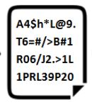
Ring-Learning with Error (R-LWE)
Public-Key Cryptosystem
Alice
Bob
TRNG
Key Generator
Module
Encryption Module
Gaussian Noise
Sampler
e
r0, r1, r2
Gaussian Noise
Sampler
Decryption Module
Notes:
RLWE based public-key cryptosystem has 3 major modules. First is the key generator module. TRNG generates a random stream of vector which is used as one of the public key. GNS generates an error vector with small noise samples. It also generates another vector which will be used by Alice as her secret key. So the key generator module takes care of generating the secret key or private key for Alice and also generating a pair of public key. Second module the encryption module wherein Bob will use the public key pair, and random vectors r0, r1 and r2 for further obfuscation and encrypt the plaintext message to generate cipher text. Bod sends the generated ciphertext to Alice. Alice will now use the decryption module to recover the plaintext message by using her secret key.

Slide 23
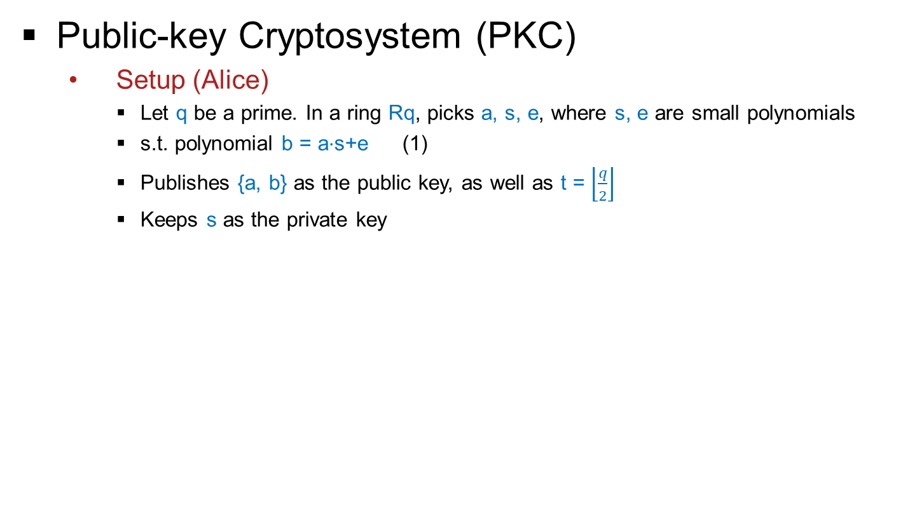
Ring-Learning with Error (Ring-LWE)
[1]
Public-key Cryptosystem (PKC)
Setup (Alice)
Let q be a prime. In a ring Rq, picks a, s, e, where s, e are small polynomials
s.t. polynomial b = a$⋅$s+e (1)
Publishes {a, b} as the public key, as well as t = $\left\lfloor \frac{q}{2}\right\rfloor$
Keeps s as the private key
[1] Oded Regev, “On lattices, learning with errors, random linear codes, and cryptography”, 2005
Notes:
Alice picks a large prime number, q and within the ring field she picks her secret key, s and also error vector, e. She also picks the first public key within the ring field. After having those values, she computes b which is the second public key using equation 1. She publishes the pair of public key i.e. a and b and also publishes the value of t which is q/2. And she keeps s as her private key.

Slide 24
Ring-Learning with Error (Ring-LWE)
With e and without s, it is as hard as CVP in lattice crypto to find out if Eq (1) stands.
But with s, it is easy for Alice to verify Eq (1), making it a good trapdoor.
[1]
Public-key Cryptosystem (PKC)
Setup (Alice)
Let q be a prime. In a ring Rq, picks a, s, e, where s, e are small polynomials
s.t. polynomial b = a$⋅$s+e (1)
Publishes {a, b} as the public key, as well as t = $\left\lfloor \frac{q}{2}\right\rfloor$
Keeps s as the private key
[1] Oded Regev, “On lattices, learning with errors, random linear codes, and cryptography”, 2005
Notes:
Any asymmetric cryptosystem requires a good trapdoor, which means it is easy for legitimate users to verify but hard for adversaries to extract the secret. It is difficult for adversaries to see the existence of s with addition of small e.

Slide 25
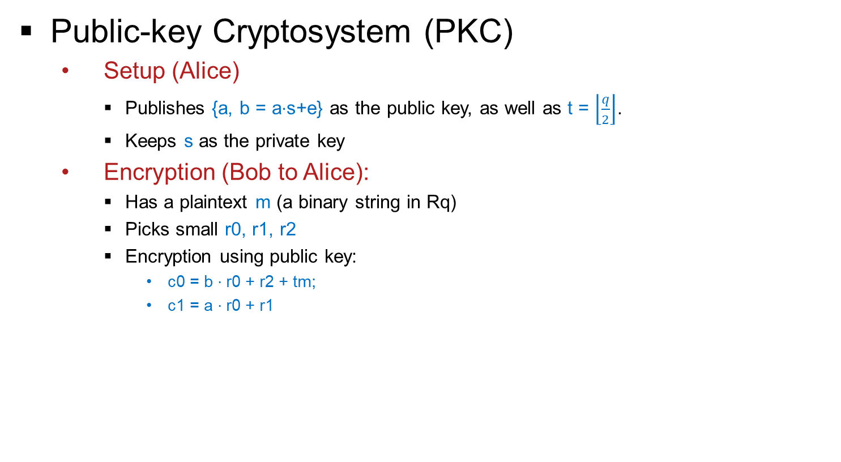
Ring-Learning with Error (Ring-LWE)
[1]
Public-key Cryptosystem (PKC)
Setup (Alice)
Publishes {a, b = a$⋅$s+e} as the public key, as well as t = $\left\lfloor \frac{q}{2}\right\rfloor$.
Keeps s as the private key
Encryption (Bob to Alice):
Has a plaintext m (a binary string in Rq)
Picks small r0, r1, r2
Encryption using public key:
c0 = b $⋅$r0 + r2 + tm;
c1 = a $⋅$r0 + r1
[1] Oded Regev, “On lattices, learning with errors, random linear codes, and cryptography”, 2005
Notes:
Bob has a plaintext m which is a binary string in ring field. He picks three random numbers r0, r1 and r2 from his noise sampler. And then he performs encryption using the public key pair. He computes two ciphers, c0 and c1 using the equations shown here.

Slide 26

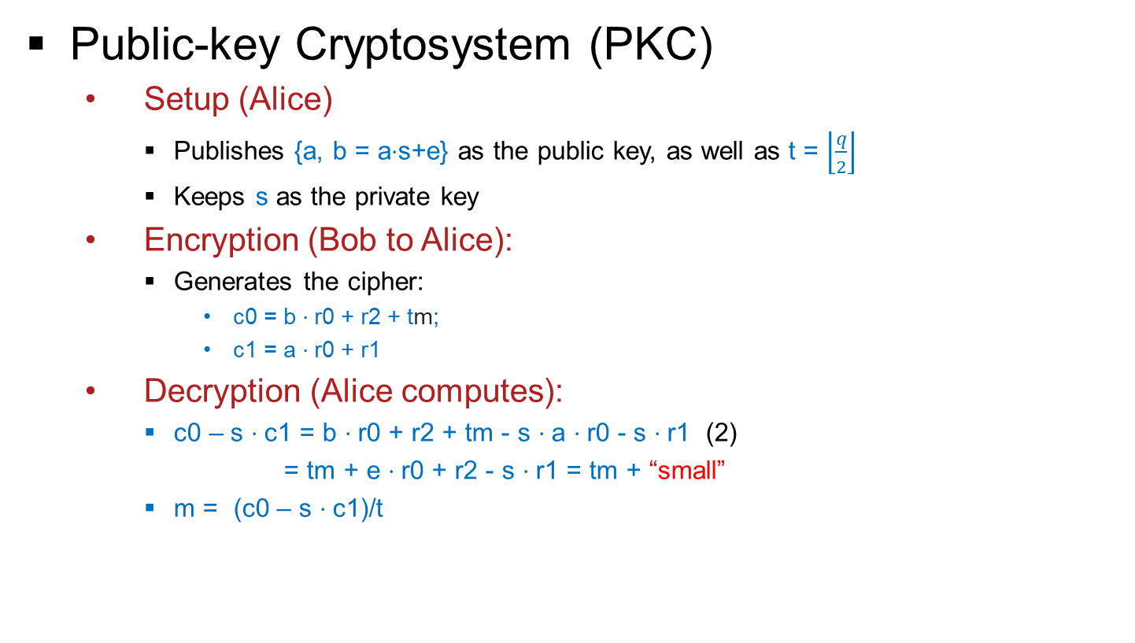
Ring-Learning with Error (Ring-LWE)
[1]
Public-key Cryptosystem (PKC)
Setup (Alice)
Publishes {a, b = a$⋅$s+e} as the public key, as well as t = $\left\lfloor \frac{q}{2}\right\rfloor$
Keeps s as the private key
Encryption (Bob to Alice):
Generates the cipher:
c0 = b $⋅$r0 + r2 + tm;
c1 = a $⋅$r0 + r1
Decryption (Alice computes):
c0 – s $⋅$c1 = b $⋅$r0 + r2 + tm - s $⋅$a $⋅$r0 - s $⋅$r1 (2)
= tm + e $⋅$r0 + r2 - s $⋅$r1 = tm + “small”
m = (c0 – s $⋅$c1)/t
e, r0, r1, r2 will be eliminated easily by Alice, but they make attacker’s life so much harder.
$$\left\lceil 1\right.\left.111q1111 \right\rfloor$$
Taking the nearest binary integer
[1] Oded Regev, “On lattices, learning with errors, random linear codes, and cryptography”, 2005
Notes:
Alice just needs to compute c0 – s.c1 and divide it by t to get the nearest binary integer. Alice knows s and she is capable of eliminating e, r0, r1. r2 easily but its not easy for an attacker to extract the message because of the trapdoor.

Slide 27
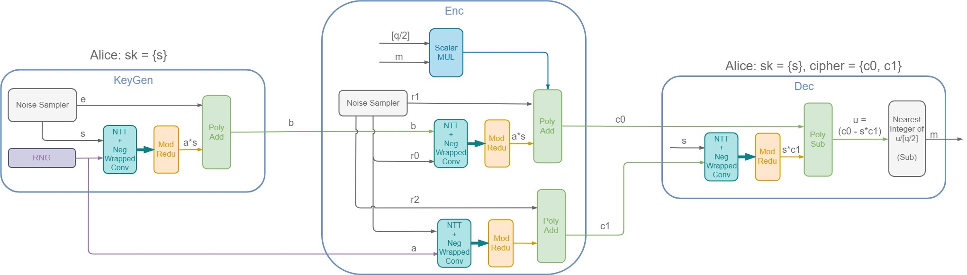
R-LWE Public Key Encryption Co-processor
[1]
Public-key Cryptosystem (PKC)
TRNG
Key Generator
Module
Encryption Module
Decryption Module
Gaussian Noise
Sampler
e
r0, r1, r2
Gaussian Noise
Sampler
[1] Oded Regev, “On lattices, learning with errors, random linear codes, and cryptography”, 2005
Notes:
So the entire Public key Encryption system will look like this. And can be basically broken down into few modules.

Slide 28
R-LWE Public Key Encryption Co-processor
Basic Operations
(Every operation is modular)
Random Number Generator
Gaussian Noise Sampler
Polynomial Addition/Subtraction
Scalar Multiplication with a Binary Polynomial
Scalar Division to the Nearest Binary Integer
Polynomial Multiplication
Size of the Polynomials/Vectors
Length: 256, 512, or 1024
Symbol: within the prime number 1,049,089
Notes:
Basic operations within each of the main module end up being random number generation, noise sampling, polynomial addition and subtraction, scalar multiplication, scalar division to the nearest binary integer and polynomial multiplication. The looks can be deceiving here, the operations appear very simple. But it is actually not. Because we have to deal with large polynomial length i.e. 256, 512 or 1024 and prime number is in the range of a million number.

Slide 29
R-LWE Public Key Encryption Co-processor
Basic Operations
(Every operation is modular)
Random Number Generator ✓
Gaussian Noise Sampler ✓
Polynomial Addition/Subtraction ✓
Scalar Multiplication with a Binary Polynomial ✓
Scalar Division to the Nearest Binary Integer ✓
Can be done by 2 subtractions
Polynomial Multiplication hard
Size of the Polynomials/Vectors
Length: 256, 512, or 1024
Symbol: within the prime number 1,049,089
Notes:
So our observation was that few of the operations are still easy but polynomial multiplication, involved in each of the key modules, is the hardest part to deal with. As it will govern the design decisions for the entire system. And as we are dealing with large n and large prime numbers, so we have to be considerate about the hardware design.

Slide 30
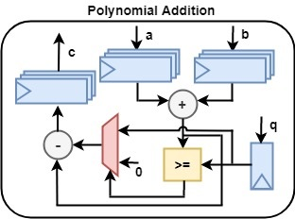
R-LWE Public Key Encryption Co-processor
Polynomial Addition
If x = [x0, x1, x2, x3], y = [y0, y1, y2, y3], then:
z = x + y = [(x0+y0)%q, (x1+y1)%q, (x2+y2)%q, (x3+y3)%q]
Notes:
Our implementation is a fully optimized and parameterized. To the best of our knowledge this is first such implementation.
This is register based approach which is shown here. One important thing to note is that, even addition and mod can be expensive when the operands are over 20 bits. For example, the mod itself takes up 500 LUTs.

Slide 31
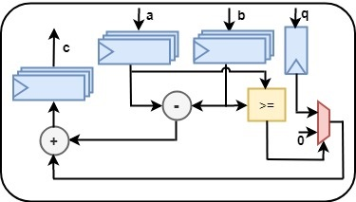
R-LWE Public Key Encryption Co-processor
Polynomial Subtraction
If x = [x0, x1, x2, x3], y = [y0, y1, y2, y3], then: z = x – y
z0 = (x0 – y0)%q = (x0 >= y0) ? (x0-y0) : (q – (y0 – x0))
Notes:
Vector subtraction is still a component-wise operation. ###However, due to the mod nature, there is no negative result

Slide 32
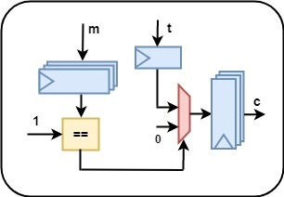
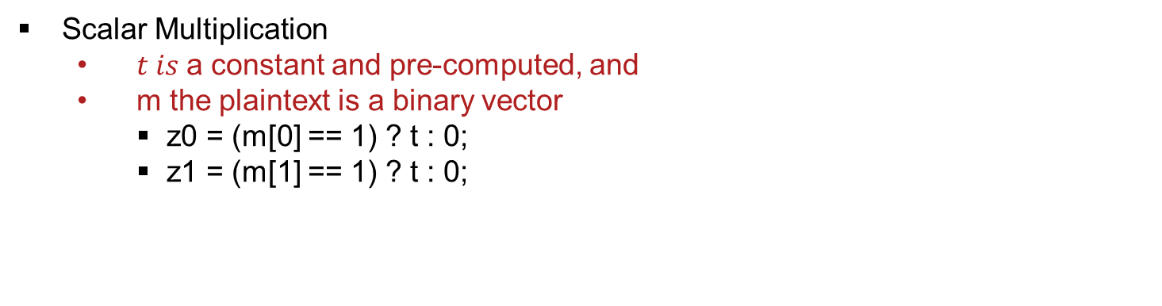
R-LWE Public Key Encryption Co-processor
Scalar Multiplication
$t is$a constant and pre-computed, and
m the plaintext is a binary vector
z0 = (m[0] == 1) ? t : 0;
z1 = (m[1] == 1) ? t : 0;
Notes:
The scalar mul is with a constant and a binary vector, so it can be done with just conditional assignments, without using mul.

Slide 33
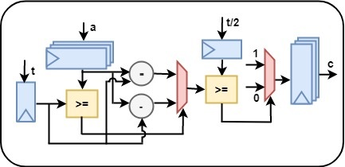
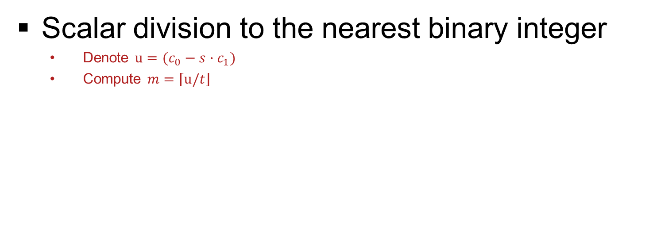
R-LWE Public Key Encryption Co-processor
Scalar division to the nearest binary integer
Denote $u=(c_{0}−s∙c_{1})$
Compute $m=\left\lceil u/\right.\left.t\right\rfloor$
Notes:
We need this operation during decryption. u can be computed by the vector multiplication and subtraction modules.
Actually, we can use a trick to compute this equation without involving any division. Absolute (u – t) measures the distance between u and t. If this distance is larger than half of t, meaning it is too far, then the nearest integer of the quotient (u/t) should be 0. If the distance is within half of t, then the nearest integer of the quotient (u/t) should be 1.
For example:
when q = 17, then t = 8, t/2 = 4
If u = [2, 9], then $m=\left\lceil u/\right.\left.t\right\rfloor$ = [0, 1]
If u = [7, 15], then $m=\left\lceil u/\right.\left.t\right\rfloor$ = [1, 0]

Slide 34
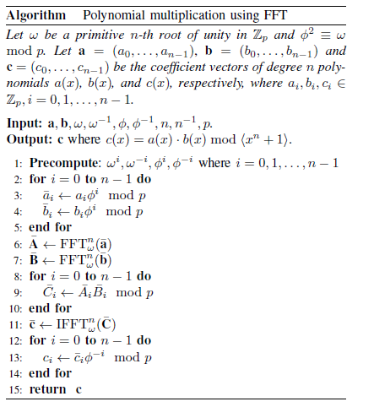
R-LWE Public Key Encryption Co-processor
Modular Polynomial Multiplication
Naïve Convolution Then Polynomial Reduction
By FFT over finite field
Negative Wrapped Convolution (NWC)
Fast Number Theoretic Transform (NTT)
Component-wise multiplication
Inverse NTT
Inverse NWC
Notes:
Naive approach to implement pol mul is using convolution and then poly. reduction. That takes a complexity of O(N^2). Using FFT over finite field also known as Number Theoretic Transform we can reduce the complexity. This is because of the convolution theorem. Con. Theorem states that convolution in one domain equals point-wise mul in the other domain. This approach reduces complexity from N^2 to NlogN. We need NWC so as to avoid extending the length of vector before performing NTT which in turn helps in avoiding poly reduction. Then we transform both multiplicands using NTT. Apply component wise multiplication. Then transformed back using iNTT, then perform iNWC. So component wise mul is basically a sandwich between convolution and transformation operations.

Slide 35
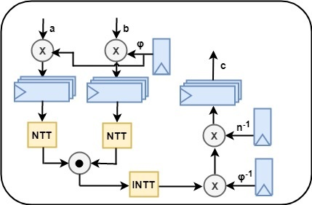
R-LWE Public Key Encryption Co-processor
Modular Polynomial Multiplication
By FFT over finite field
Notes:
Hardware circuit implementation for the polynomial multiplication alogrithm

Slide 36
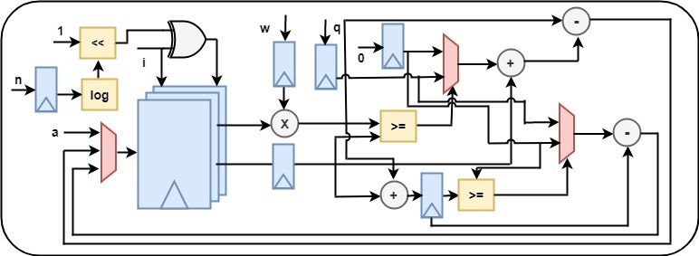
R-LWE Public Key Encryption Co-processor
Modular Polynomial Multiplication
By FFT over finite field
Notes:
Our implementation of NTT is fully parameterized and optimized. Though there exists hardware implementations of NTT algorithms, they are very expensive in terms of hardware cost, power and latency. This is because prior implementations perform a large number of multiplications and divisions in computing the indexes of the points. This may not be an issue for software implementations. However, for hardware implementations those multiplications and divisions consume large numbers of LUTs.

Slide 37
R-LWE Public Key Encryption Co-processor
Our Design Goals
Low hardware cost
Want to fit everything on one FPGA
1 DSP multiplier, 1 adder, 1 subtractor, 1 mod reductor
Latency (trade-off)
Estimated: 34,816 cycles, 35 milliseconds
Notes:
Our primary design goal was to have low hardware cost which means that we want to fit everything on to one FPGA and we want to use just one DSP multiplier, one adder, one subtractor and one mod redactor. But for this design approach we have to trade-off the latency. We estimated the cycles that will be required for our co-processor and it comes to around 34, 816 cycles which will take about 35 ms to perform the operation. Let’s see the observed performance.

Slide 38
R-LWE Public Key Encryption Co-processor
Implementation Results
Notes:
First we compare the latency of our NTT-based polynomial multiplier to two other similar implementations. We observed that for polynomial length, n ranging from
256 to 2048, performance improvement of about 23% when compared to Chen et al. and about 71% when compared to P¨oppelmann et al.

Slide 39
R-LWE Public Key Encryption Co-processor
Implementation Results
Notes:
Here is the latency of the entire PKC system. Latency is directly proportional to the polynomial length. As the polynomial length increases the latency increases.

Slide 40
R-LWE Public Key Encryption Co-processor
Implementation Results
Notes:
Hardware cost for PKC which is proportional to both polynomial length and the value of the prime number.
We have submitted a paper in FPL conference on this implementation.

Slide 41
Presentation Flow
Motivation
Why quantum-proof?
NIST
Steps towards standardization
Design Workflow
R-LWE
State of the art
Implementation
Results
Code-based
State of the art
Proposed algorithm

Slide 42
Post-Quantum Cryptography (PQC) Standardization (Round -2)
NIST
Jan 30, 2019 published candidates of Round-2:
27 submissions
Who survived?
12 lattice-based
8 code-based
some multivariate-based and hash based for digital signatures
Notes:
Having said that let’s look at the candidates of second round. On Jan 30, 2019 NIST published first round results. Out of some 69 submissions only 27 submissions were declared as the second round candidates. Who survived the battle? Lattice based, code based and few other multivariate based and some hash-based for digital signatures.

Slide 43
Why Code-based Cryptosystem?
It has withstood the test of time
Published in 1978, 40 years of examination
The security reduction (hardness) is decoding of linear codes without knowing the encoding algorithm
NP-hard for quantum computers
Although:
Its key size is large: 1MB
Its decryption is highly parallel: easy for both good & bad guys

Slide 44
The Interesting Connection Between Code-based and R-LWE Cryptosystems
Ring-Learning with Errors
Trapdoor function: a⋅s + e = b
a, b: the public key
s: the secret key
e: the noise/error
Code-based
Trapdoor function: m⋅G + e = c
m, c: the plaintext message and cipher
G: the encoding matrix (secret key)
e: the error
Both are NP-hard for classical and quantum computers

Slide 45
Code-based Encryption
McEliece cryptosystem
Error Correction Code (ECC)
A (n, k, t) ECC code C:
k: size of your message (information)
n: size of the encoded message (codeword)
t: # of random errors C can tolerate

Slide 46

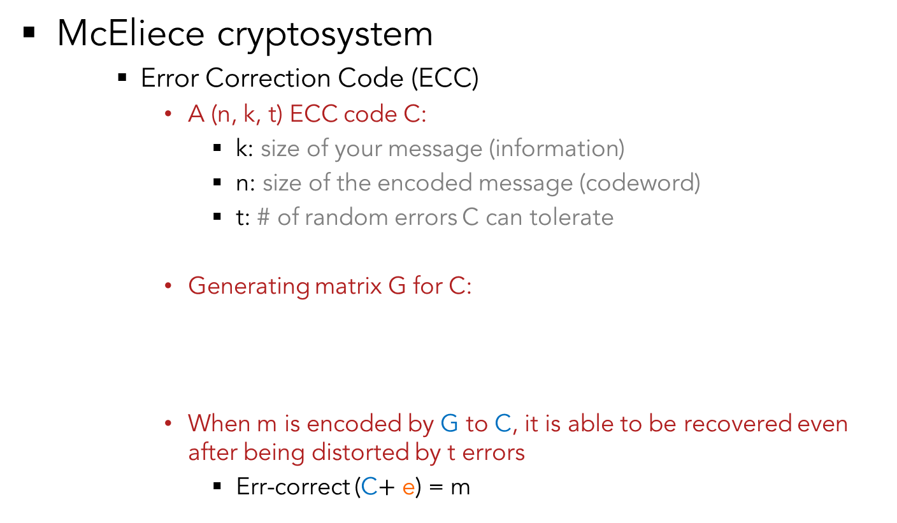

Code-based Encryption
McEliece cryptosystem
Error Correction Code (ECC)
A (n, k, t) ECC code C:
k: size of your message (information)
n: size of the encoded message (codeword)
t: # of random errors C can tolerate
Generating matrix G for C:
When m is encoded by G to C, it is able to be recovered even after being distorted by t errors
Err-correct (C$+$ e) = m
C
1
n
G
n
$$×$$
k
k
$$=$$
1
m

Slide 47
Code-based Encryption
McEliece cryptosystem
Error Correction Code (ECC)
A (n, k, t) ECC code C:
k: size of your message (information)
n: size of the encoded message (codeword)
t: # of random errors C can tolerate
Generating matrix G for C:
When m is encoded by G to C, it is able to be recovered even after being distorted by t errors
Err-correct (C$+$ e) = m
C
Nothing secret to anyone.
1
n
G
n
$$×$$
k
k
$$=$$
1
m

Slide 48

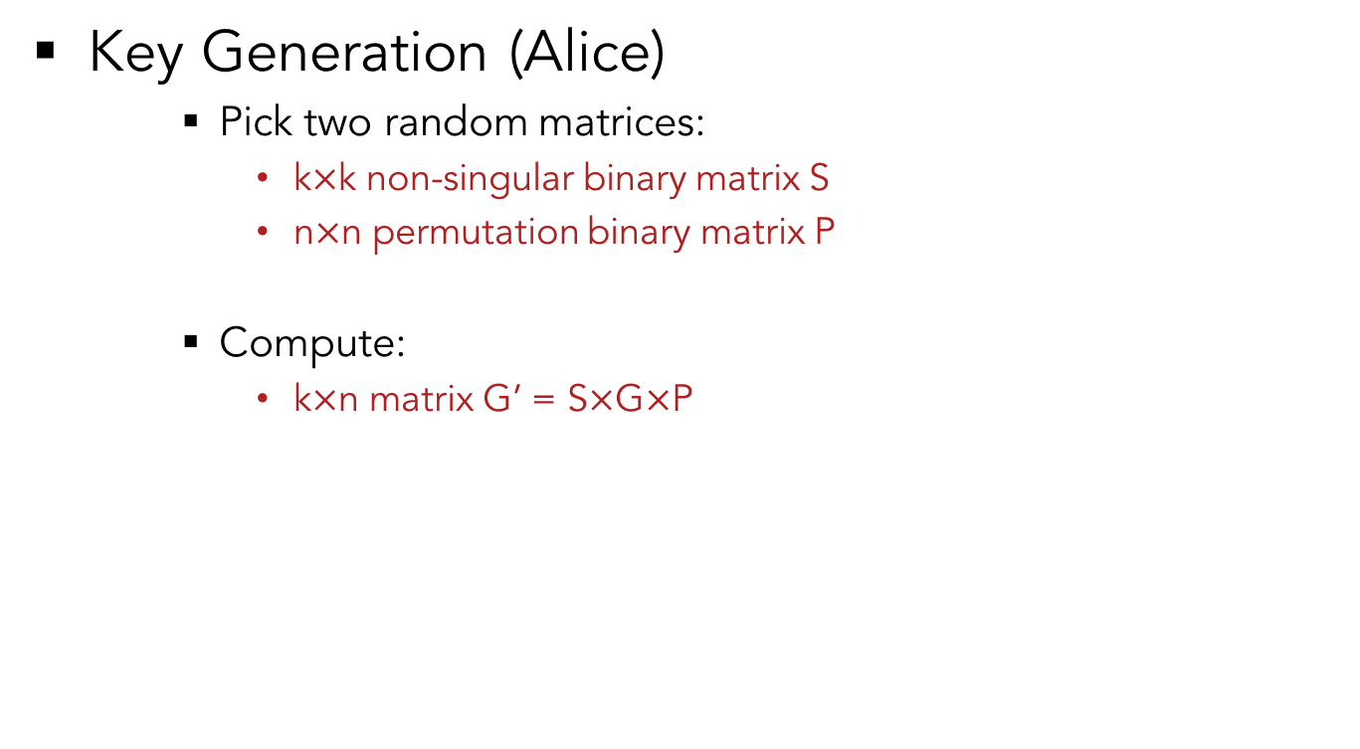


Code-based Encryption
Key Generation (Alice)
Pick two random matrices:
k$×$k non-singular binary matrix S
n$×$n permutation binary matrix P
Compute:
k$×$n matrix G’ = S$×$G$×$P
s
G
P
G’
$$×$$
$$×$$
$$=$$
For obfuscation
of G

Slide 49
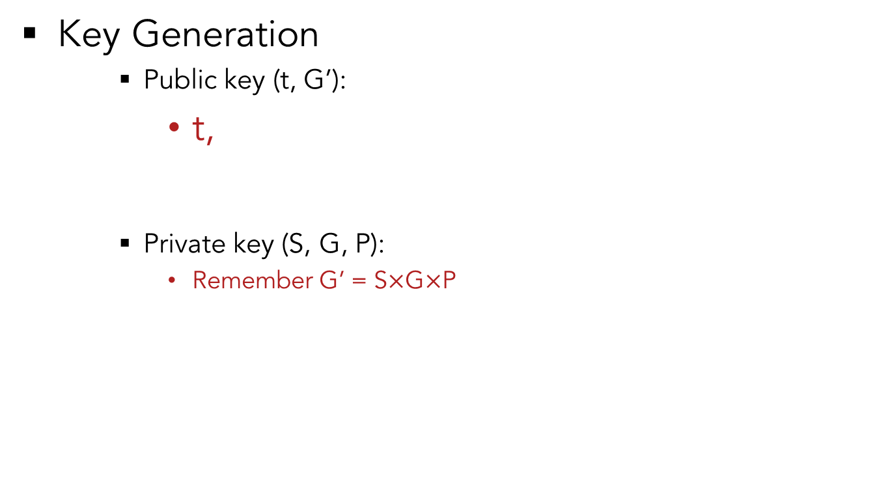
Code-based Encryption
Key Generation
Public key (t, G’):
t,
Private key (S, G, P):
Remember G’ = S$×$G$×$P
G’
s
G
P

Slide 50




Code-based Encryption
McEliece cryptosystem
Encryption (Bob to Alice):
Message (plaintext) encrypted to codeword
Codeword obfuscated by an error to cipher
C
G’
$$×$$
m
$$=$$
C
e (t of 1’s)
Cipher
$$+$$
$$=$$

Slide 51
Code-based Encryption
McEliece cryptosystem
Encryption (Bob to Alice):
Message (plaintext) encrypted to codeword
Codeword obfuscated by error to cipher
C
G’
Can be arbitrarily chosen. Will be eliminated later but makes attack difficult.
$$×$$
m
$$=$$
C
e (t of 1’s)
Cipher
$$+$$
$$=$$

Slide 52
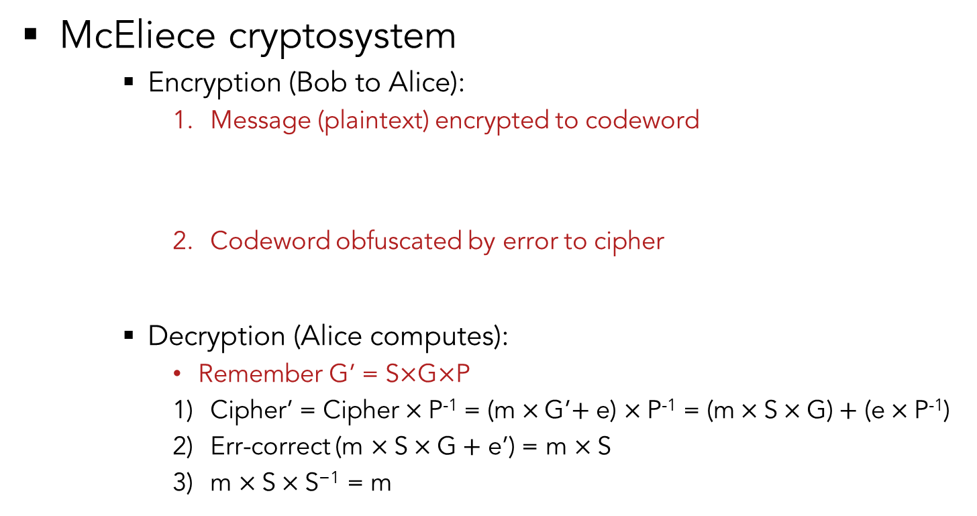
Code-based Encryption
McEliece cryptosystem
Encryption (Bob to Alice):
Message (plaintext) encrypted to codeword
Codeword obfuscated by error to cipher
Decryption (Alice computes):
Remember G’ = S$×$G$×$P
Cipher’ = Cipher$×$P⁻¹ = (m$×$G’$+$ e) $×$P⁻¹ = (m$×$S$×\text{G}\text{)}+$ (e$×$P⁻¹)
Err-correct (m $×\text{S}×\text{G}+$ e’) = m $×\text{S}$
m $×\text{S}×\text{S}\text{−1}$ = m
C
G’
Can be arbitrarily chosen. Will be eliminated anyways but makes attack difficult.
$$×$$
m
$$=$$
C
e (t of 1’s)
Cipher
$$+$$
$$=$$

Slide 53
Code-based Encryption
McEliece cryptosystem
Encryption (Bob to Alice):
Message (plaintext) encrypted to codeword
Codeword obfuscated by error to cipher
Decryption (Alice computes):
Remember G’ = S$×$G$×$P
Cipher’ = Cipher$×$P⁻¹ = (m$×$G’$+$ e) $×$P⁻¹ = (m$×$S$×\text{G}\text{)}+$ (e$×$P⁻¹)
Err-correct (m $×\text{S}×\text{G}+$ e’) = m $×\text{S}$
m $×\text{S}×\text{S}\text{−1}$ = m
C
G’
Can be arbitrarily chosen. Will be eliminated anyways but makes attack difficult.
$$×$$
m
$$=$$
C
e (t of 1’s)
Cipher
$$+$$
$$=$$
Attacker does not know: S, G, P
Thus he/she cannot compute:
S⁻¹, Err-correct(e), P⁻¹
Therefore, he/she does not know m

Slide 54
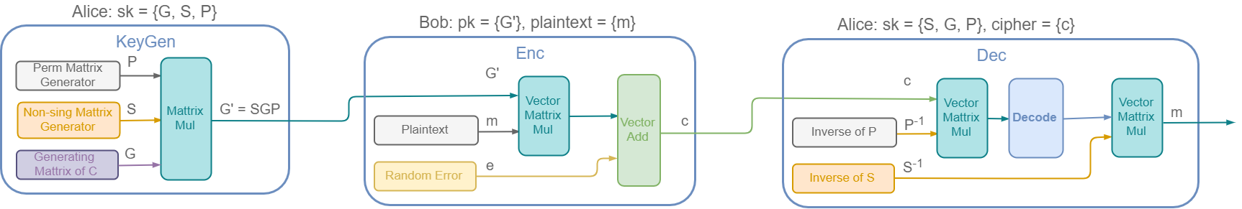
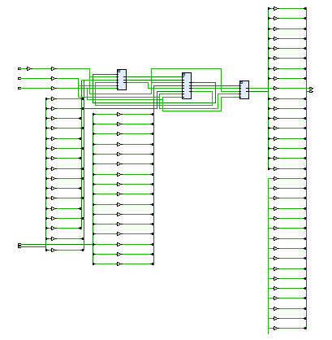
Code-based Encryption
Architecture
Key Generation
Encryption
Decryption

Slide 55
Code-based Encryption
Can we make it faster?
The original scheme uses binary Goppa codes
Encoding & decoding involves
Long polynomial division
Solving equations over finite fields

Slide 56
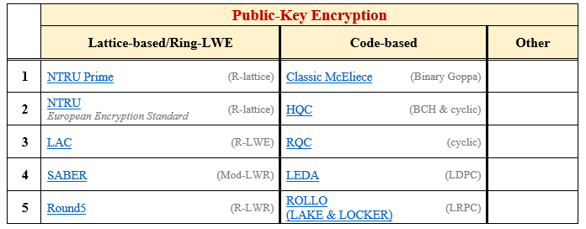
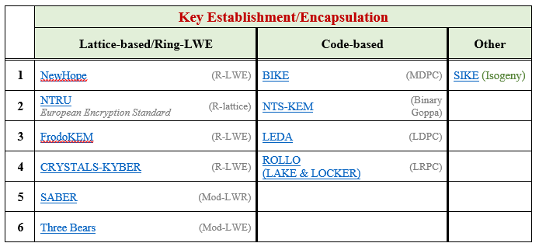
Code-based Encryption
Can we make it faster?

Slide 57
Code-based Encryption
Can we make it faster?
The original scheme uses binary Goppa codes
Encoding & decoding involves
Long polynomial division
Solving equations over finite fields
We propose using Orthogonal Latin Square Codes
Encoding & decoding involves
Binary operations only
Can be fully parallel

Slide 58
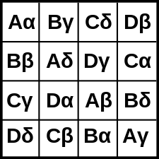
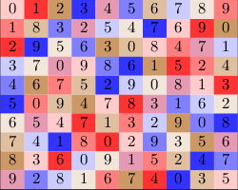
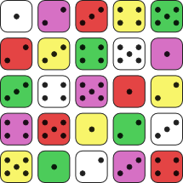
Code-based Encryption
Orthogonal Latin Square Codes (OLSC)

Slide 59
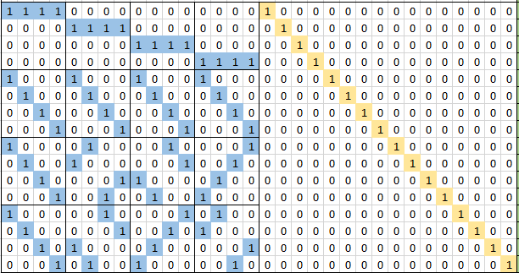
Code-based Encryption
Orthogonal Latin Square Codes (OLSC)

Slide 60
Code-based Encryption
Orthogonal Latin Square Codes (OLSC)
A 1 0 1 0 0 0 0 0 0 0 0 0 0 0 0 0
B 0 0 0 0 0 0 0 0 1 0 0 0 1 0 0 0
A
B

Slide 61
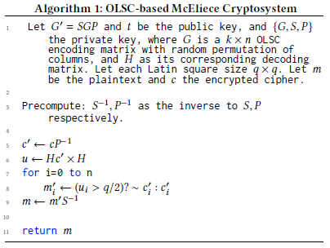
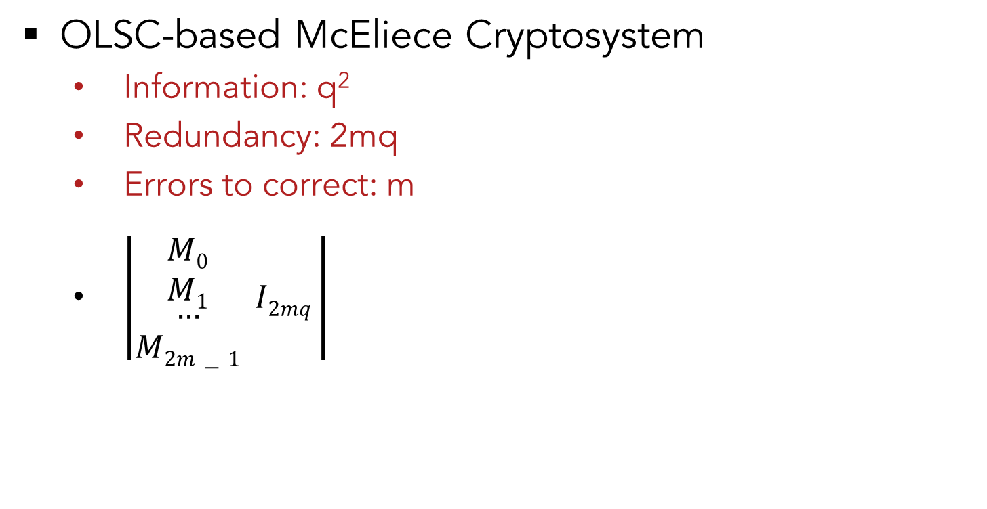
Code-based Encryption
OLSC-based McEliece Cryptosystem
Information: q²
Redundancy: 2mq
Errors to correct: m
$\left|\begin{matrix}\begin{aligned}M0 \\ M1\end{aligned} \\ … \\ M2m−1\end{matrix} I2mq \right|$

Slide 62
Code-based Encryption
OLSC-based McEliece Cryptosystem
Code | Time Complexity
Binary-Goppa | O(n²)
OLSC | O(1)

Slide 63
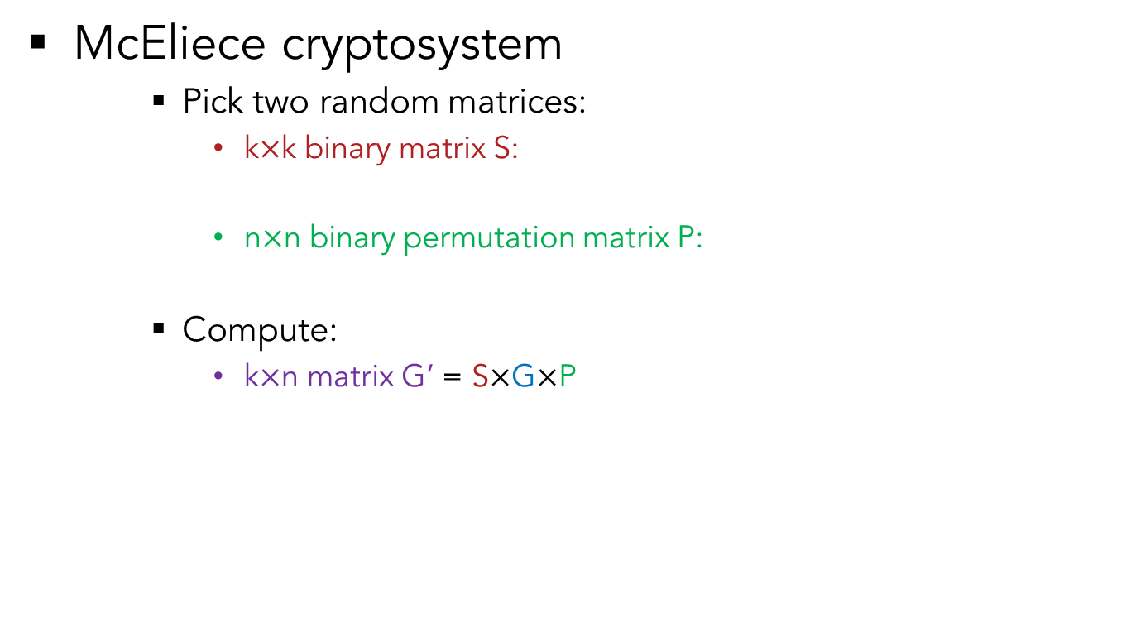
Recall that …
k
McEliece cryptosystem
Pick two random matrices:
k$×$k binary matrix S:
n$×$n binary permutation matrix P:
Compute:
k$×$n matrix G’ = S$×$G$×$P
s
k
P
n
n
s
G
P
G’
$$×$$
$$×$$
$$=$$

Slide 64
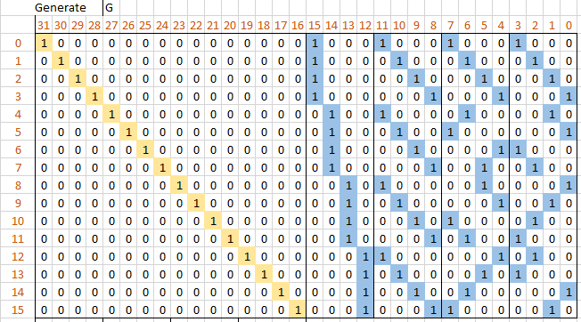
Code-based Encryption
G (the private key)
From a t= 2 double error-correcting OLSC code

Slide 65
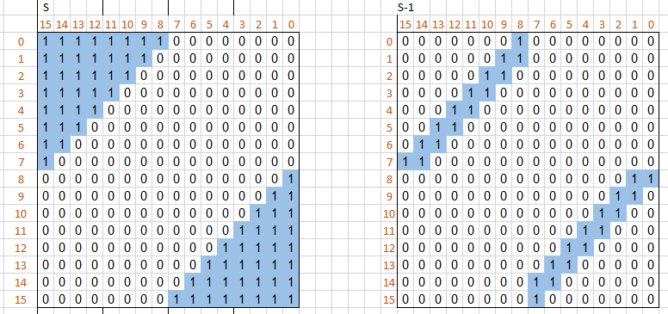
Code-based Encryption
S and its inverse (the private key)

Slide 66
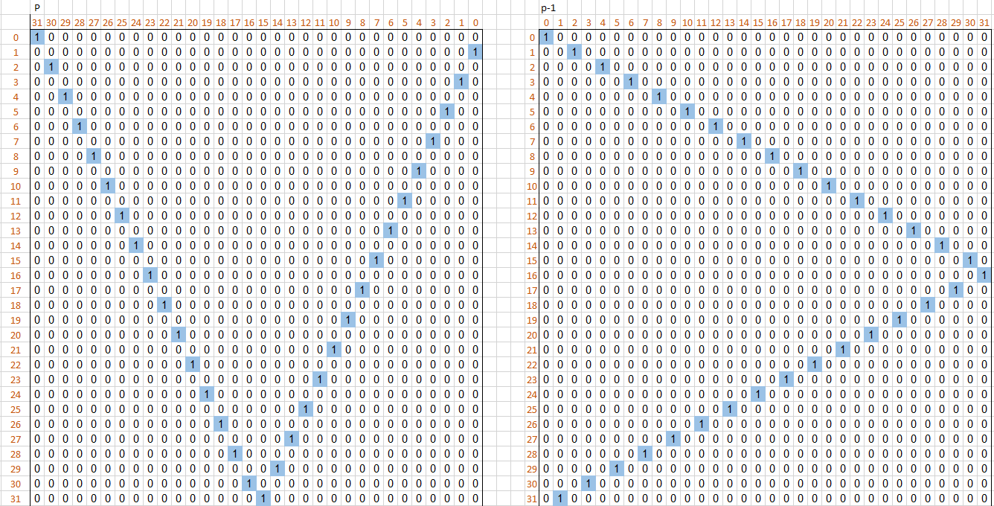
Code-based Encryption
P and its inverse (the private key)

Slide 67
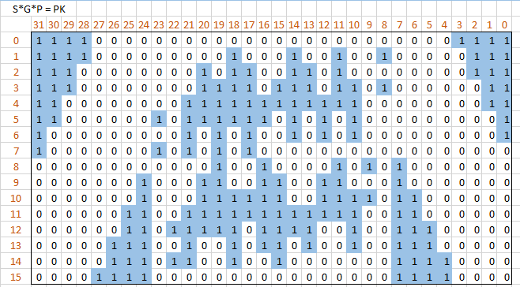
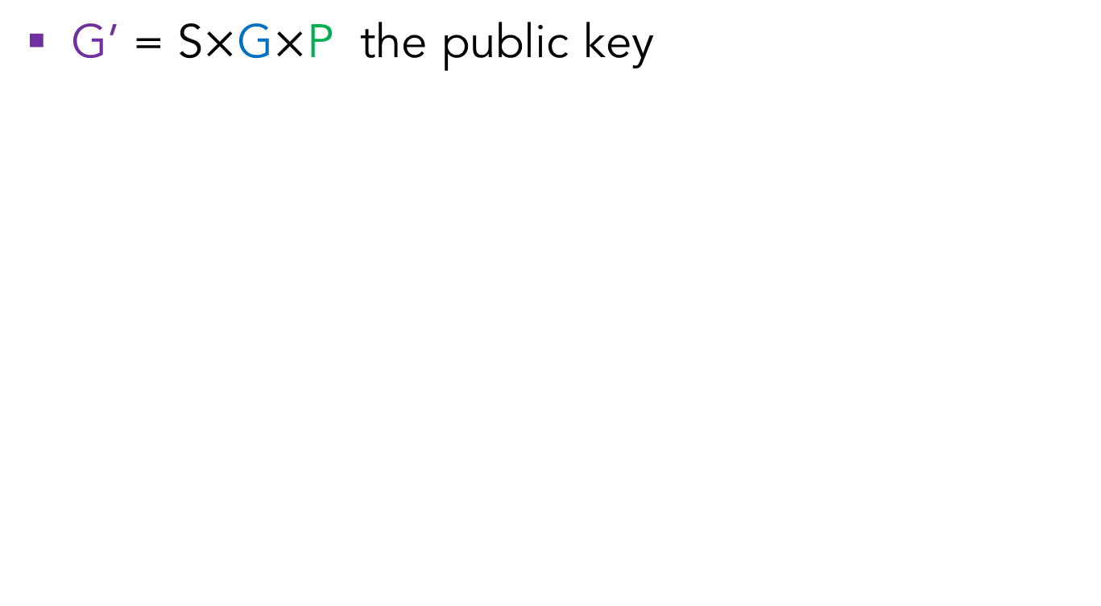
Code-based Encryption
G’ = S$×$G$×$P the public key

Slide 68
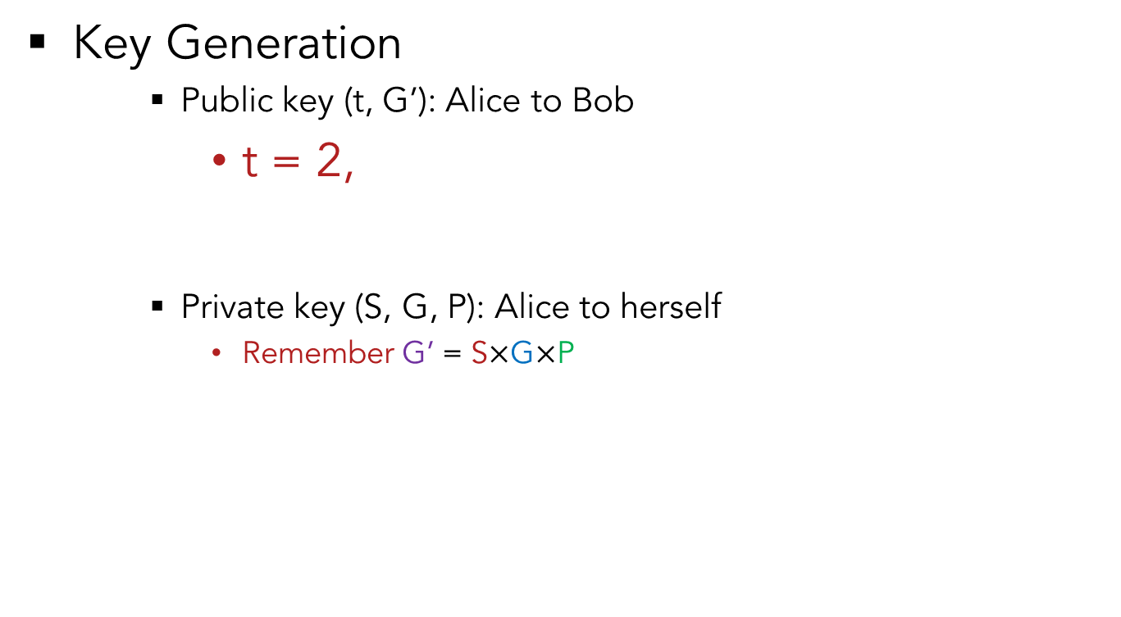
Code-based Encryption
Key Generation
Public key (t, G’): Alice to Bob
t = 2,
Private key (S, G, P): Alice to herself
Remember G’ = S$×$G$×$P
G’
s
G
P

Slide 69
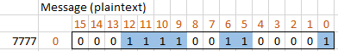


Code-based Encryption
Encryption (Bob to Alice)
Message (plaintext) encrypted to codeword
C
G’
$$×$$
m
$$=$$
7777
$$×$$
$$=$$

Slide 70




Code-based Encryption
Encryption (Bob to Alice)
Message (plaintext) encrypted to codeword
Codeword obfuscated by error to cipher
C
e (t of 1’s)
Cipher
$$+$$
$$=$$
$$+$$
$$=$$

Slide 71
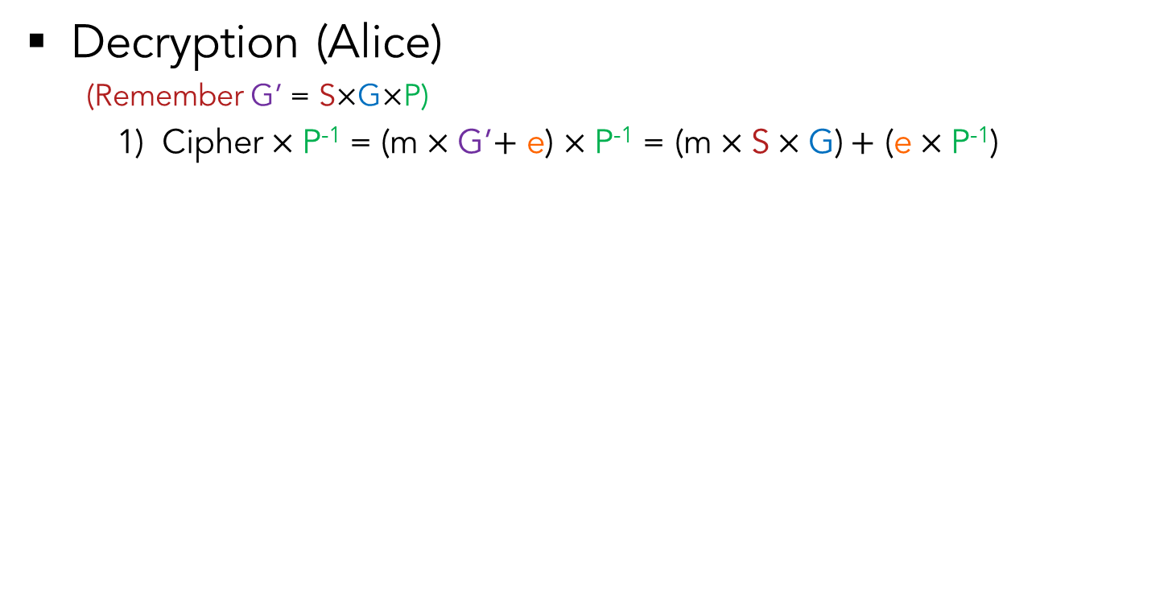

Code-based Encryption
Decryption (Alice)
(Remember G’ = S$×$G$×$P)
Cipher$×$P⁻¹ = (m$×$G’$+$ e) $×$P⁻¹ = (m$×$S$×\text{G}\text{)}+$ (e$×$P⁻¹)
$$×$$
=

Slide 72
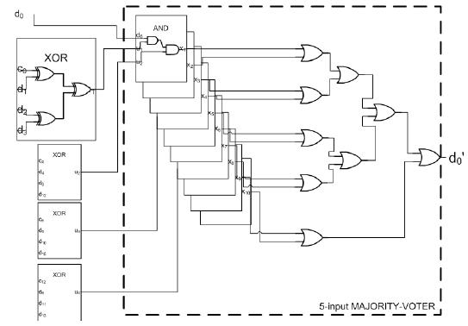
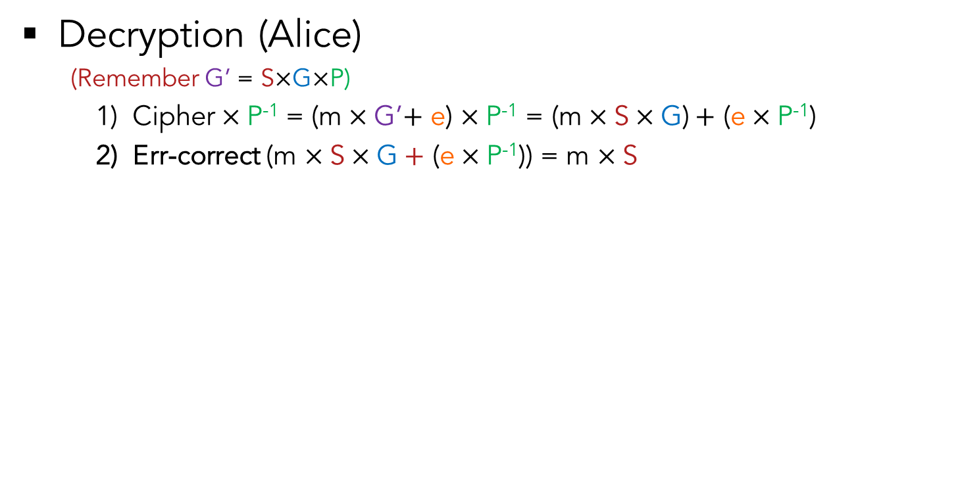
Code-based Encryption
Decryption (Alice)
(Remember G’ = S$×$G$×$P)
Cipher$×$P⁻¹ = (m$×$G’$+$ e) $×$P⁻¹ = (m$×$S$×\text{G}\text{)}+$ (e$×$P⁻¹)
Err-correct (m $×\text{S}×\text{G}+$ (e$×$P⁻¹)) = m $×\text{S}$
Err-correct ( )
Binary Matrix Multiplication Majority Voting
Majority Voting Unit

Slide 73



Code-based Encryption
Attacker does not know: S, G, P
Thus he/she cannot compute:
S⁻¹, Err-correct( ), P⁻¹
Therefore, he/she does not know m
Decryption (Alice)
(Remember G’ = S$×$G$×$P)
Cipher$×$P⁻¹ = (m$×$G’$+$ e) $×$P⁻¹ = (m$×$S$×\text{G}\text{)}+$ (e$×$P⁻¹)
Err-correct (m $×\text{S}×\text{G}+$ (e$×$P⁻¹)) = m $×\text{S}$
m $×\text{S}×\text{S}\text{−1}$ = m
7777
m
$$×$$
=
=

Slide 74

Code-based Encryption
Simulation successful
Able to encrypt & decrypt 16-bit plaintexts

Slide 75
Code-based Encryption
Simulation successful
Able to encrypt & decrypt 16-bit plaintexts

Slide 76

What needs to be done?
McEliece cryptosystem
Post-quantum secure key size:
k$×$n matrix G’: k = 5413, n = 6960, t = 119
Key size: 1mb for 128-bit security (RSA usually 2048 bits)
Crypto-analysis
Key space (G, S, P)
Decoding techniques
G’

Slide 77

Any Questions?

